Slide 1



DEPARTMENT OF ELECTRONICS AND COMMUNICATION ENGINEERING DESIGN OF MIMO ANTENNA FOR COMMUNICATION SYSTEMS
PRESENTED BY: GIUDE NAME:
NITHISHKUMAR C [927621BEC140] Dr.K.KARTHIKEYAN
SARAN S [927621BEC184] Associate Professor
PRAKASHKUMAR M [927621BEC309]

Slide 2
ABSTRACT
In fifth-generation (5G) communication systems, the use of multiple input, multiple output (MIMO) antenna technology satisfies the need for higher data speeds and more channel capacity. MIMO systems use several antennas inside mobile terminals to improve communication and spectrum efficiency.
The rise of MIMO technology as a viable option for wireless communication offers increased effectiveness and performance.
Traditional F-type topologies are usually restricted to dual-frequency bands, even though they have made MIMO miniaturization easier.
Many designs of triple-band antennas have been created to maximize the utilization of the spectrum. These designs frequently use methods to achieve numerous frequency bands, such as slot apertures and etchings or coupled feed and parasitic arms.
Three-segment zigzag patches and shared feeder connections to microstrip lines are two examples.
However, these developments frequently lead to greater antenna volumes, which restricts their usefulness. Subsequent efforts ought to concentrate on improving MIMO antenna designs to achieve a balance between small form factors and performance enhancement.

Slide 3
OBJECTIVES
The main objective of this project is to understand the working and the design of the antenna.
To design the antenna according to designed specifications.
To be acquainted with some of the characteristics of parasitic antenna element modelling and operations.
To know the antenna radiation pattern.
To perform fastest data transfer
Test antenna and verify it performs as expected.

Slide 4
EXISTING METHOD
For multi input multi output (MIMO) functioning, a new tri-band monopole antenna is mirrored. Although grounded antennas meet all the requirements and are therefore commonly employed, their large size and three-dimensional shape make them impractical. As a result, MIMO antennas are becoming more common.
It has been thoroughly studied that MIMO technology can increase data transmission speed and provides resistance against multiple path fading.
The FR4 Substrate, upon which the MIMO antenna is developed, generates its tri band performance through its antenna design.
Based on the comparison, it can be concluded that the proposed MIMO antenna offers greater accomplishments and foregoing antenna qualities, which are required for the modern mobile devices that are heading toward 5G wireless systems

Slide 5
PROPOSED METHOD
Reflected grounded antennas are a novel type of antenna used for multi input multi output (MIMO) operations. They meet all the requirements and are typically utilized, but their large size and three-dimensional shape make them impractical. Thus, MIMO antennas are becoming more and more common.
It has been thoroughly studied that MIMO technology can increase data transmission speed and provides resistance against multiple path fading. The tri-band performance of the FR4 Substrate, upon which the MIMO antenna is based, is produced by the antenna design.
The MIMO performance and radiation parameters of the suggested 5G smartphone antenna array are representations of the diversity antenna element's design and features. It looks into the intended smartphone antenna array's radiation behavior close to the user.
Ansoft HFSS software is used to model the beams in the proposed structure. Beam forming antennas' reduced power needs for antenna design huge MIMO systems' lower power consumption and amplifier expenses are the consequence of cost savings and signal transmission to the intended user.

Slide 6
SOFTWARE USED
Ansys HFSS.
HFSS - High Frequency Structure Simulator

Slide 7
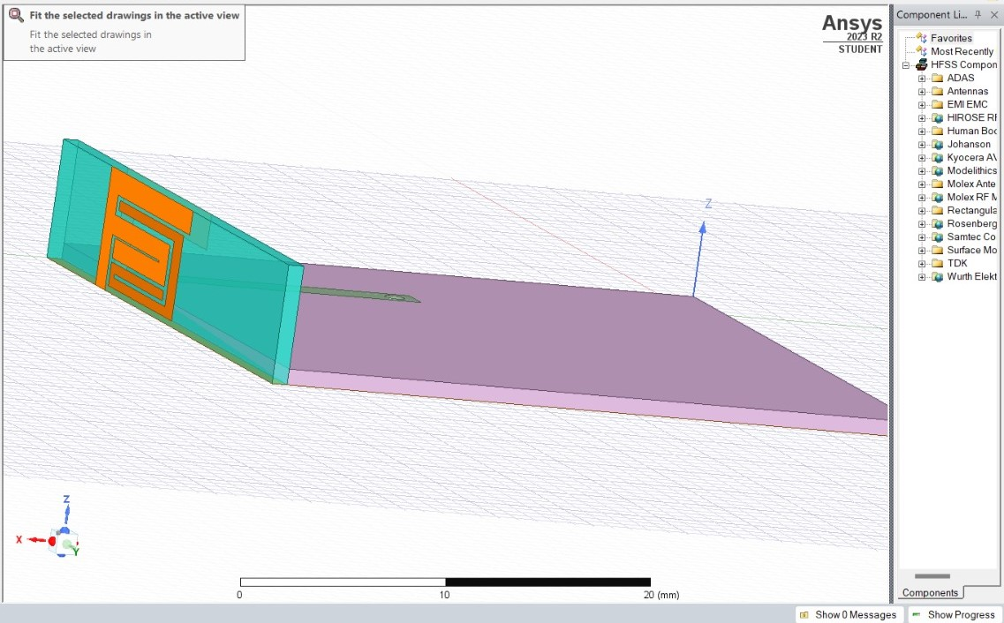
PROPOSED DESIGN

Slide 8
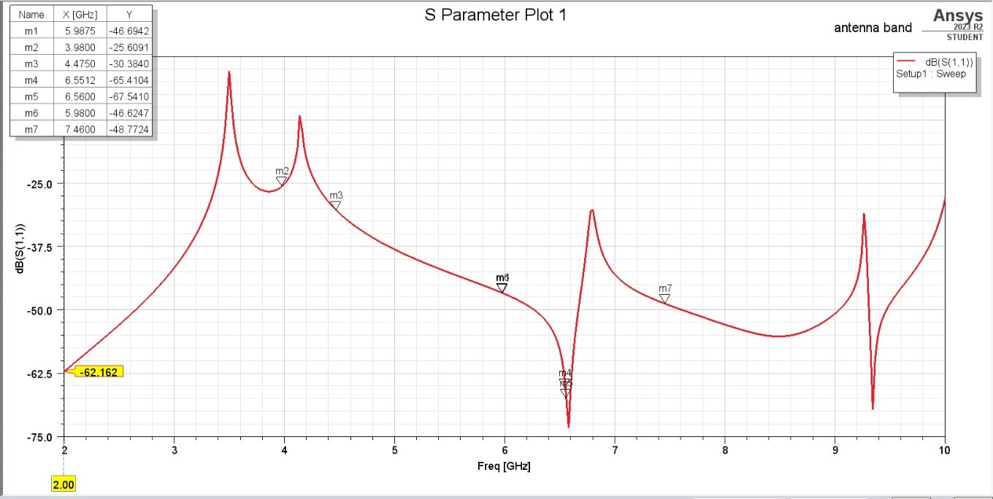
S PARAMETER

Slide 9
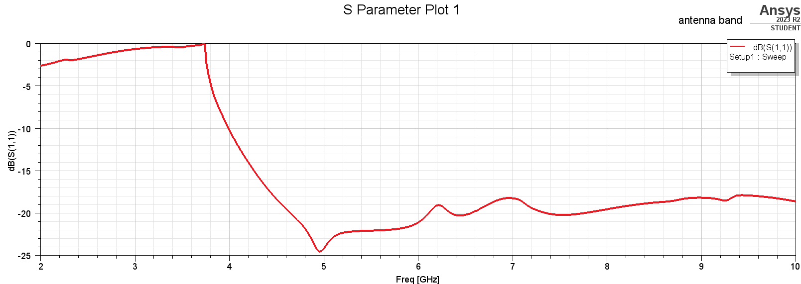
RETURN LOSS

Slide 10
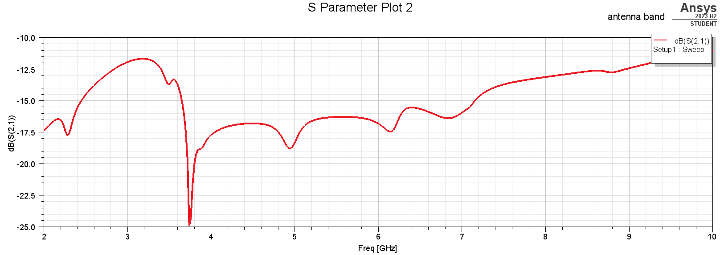
INSERTION LOSS

Slide 11
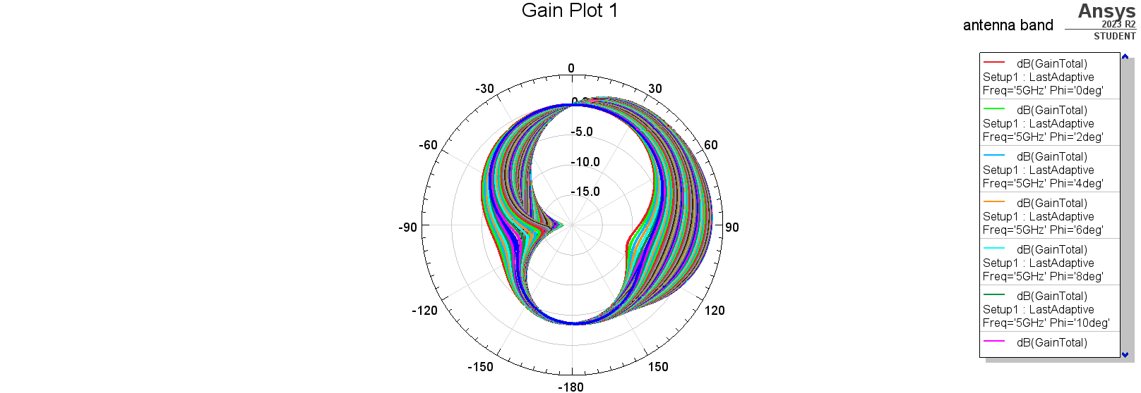
GAIN

Slide 12
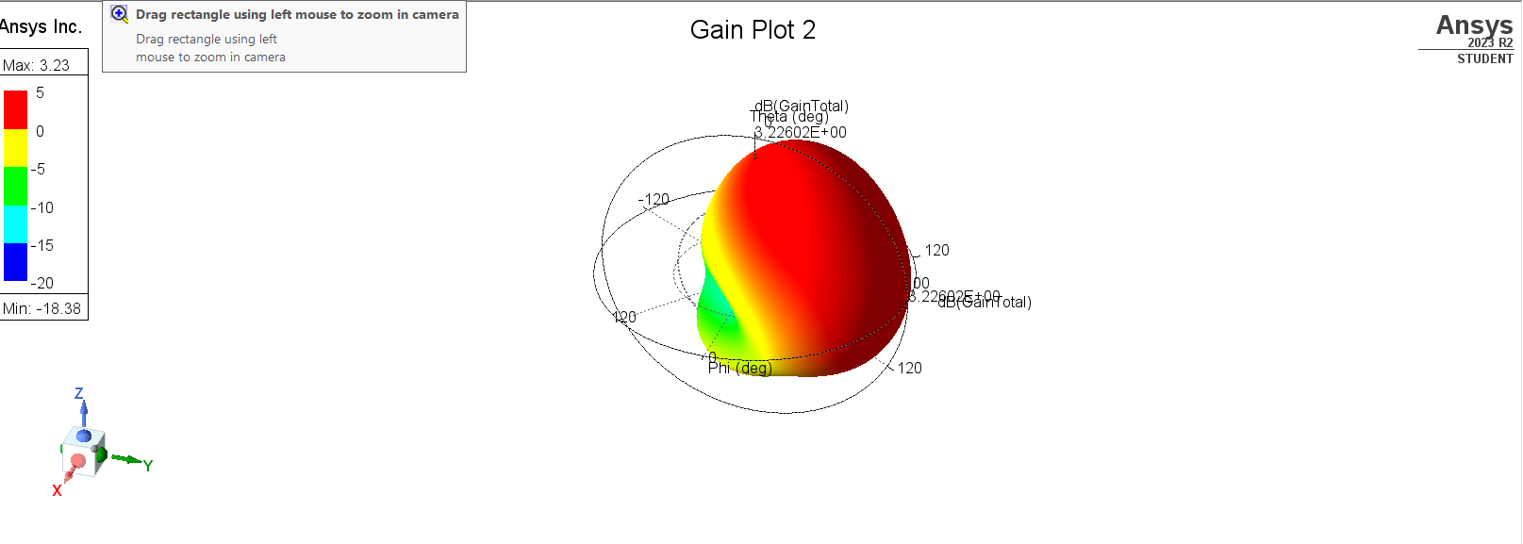
RADIATION PATTERN

Slide 13
REFERENCES
J. G. Andrews, et al, “What will 5G be?,” IEEE Journal on Selected Areas in Communications, vol. 32, no. 6, pp. 1065-1082, June 2014.
Z. Ren, A. Zhao and S. Wu, "Dual-Band MIMO Antenna System for 5G Mobile Terminals," 2019 13th European Conference on Antennas and Propagation (EuCAP), Krakow, Poland, 2019, pp. 1-4.
S. Nej and A. Ghosh, "Design of Meander Line Triple Band Antenna for Wireless Applications," 2020
S. A. Busari, S. Mumtaz, S. Al-rubaye, and J. Rodriguez, “5G Millimeter-Wave Mobile Broadband : Performance and Challenges,” IEEE Commun. Mag., vol. 56, no. 6, pp. 137–143, 2018.
M. S. Sharawi, “Printed multi-band MIMO antenna systems and their performance metrics,” IEEE Antennas Propag. Mag., vol. 55, no. 5, pp. 218–232, 2013.
I. Shayea, T. A. Rahman, M. H. Azmi, and R. Islam, “Real Measurement Study for Rain Rate and Rain Attenuation Conducted Over 26 GHz Microwave 5G Link System in Malaysia,” IEEE Access, vol. 6, pp. 19044–19064, 2018.
N. Al-falahy and O. Y. K. Alani, “Millimetre wave frequency band as a candidate spectrum for 5G network architecture : A survey,” Phys. Commun., vol. 32, pp. 120– 144, 2019..

Slide 14
OUTCOME
International conference on recent development in engineering & technology – ICRDET’24
https://www.ijircce.com/special-issues/pdf/2024/icrdet%202024/29_Design.pdf

Slide 15


